Slide 1
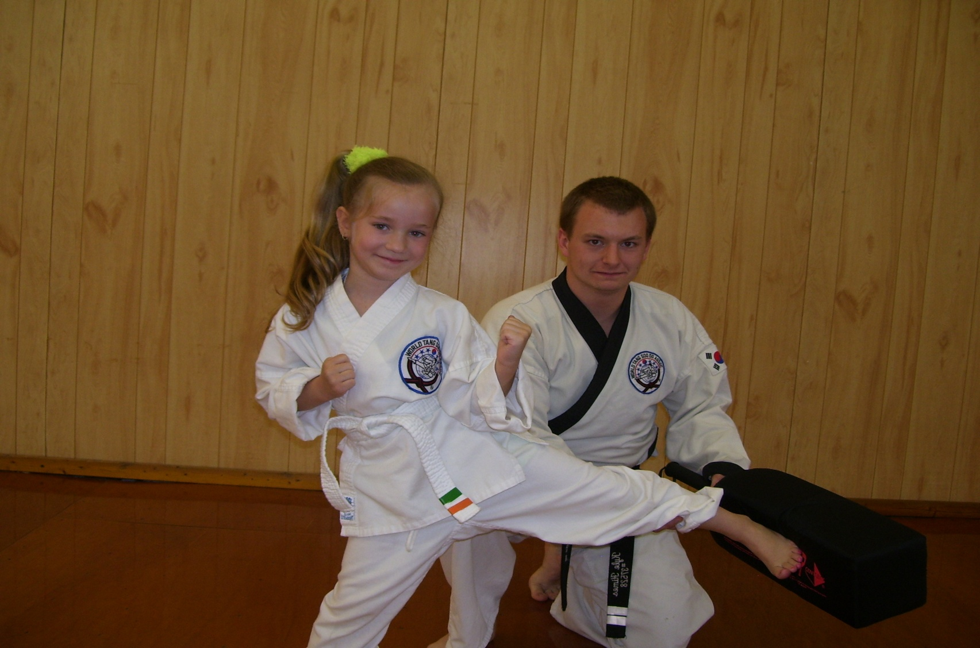
Martial Arts School

Slide 2
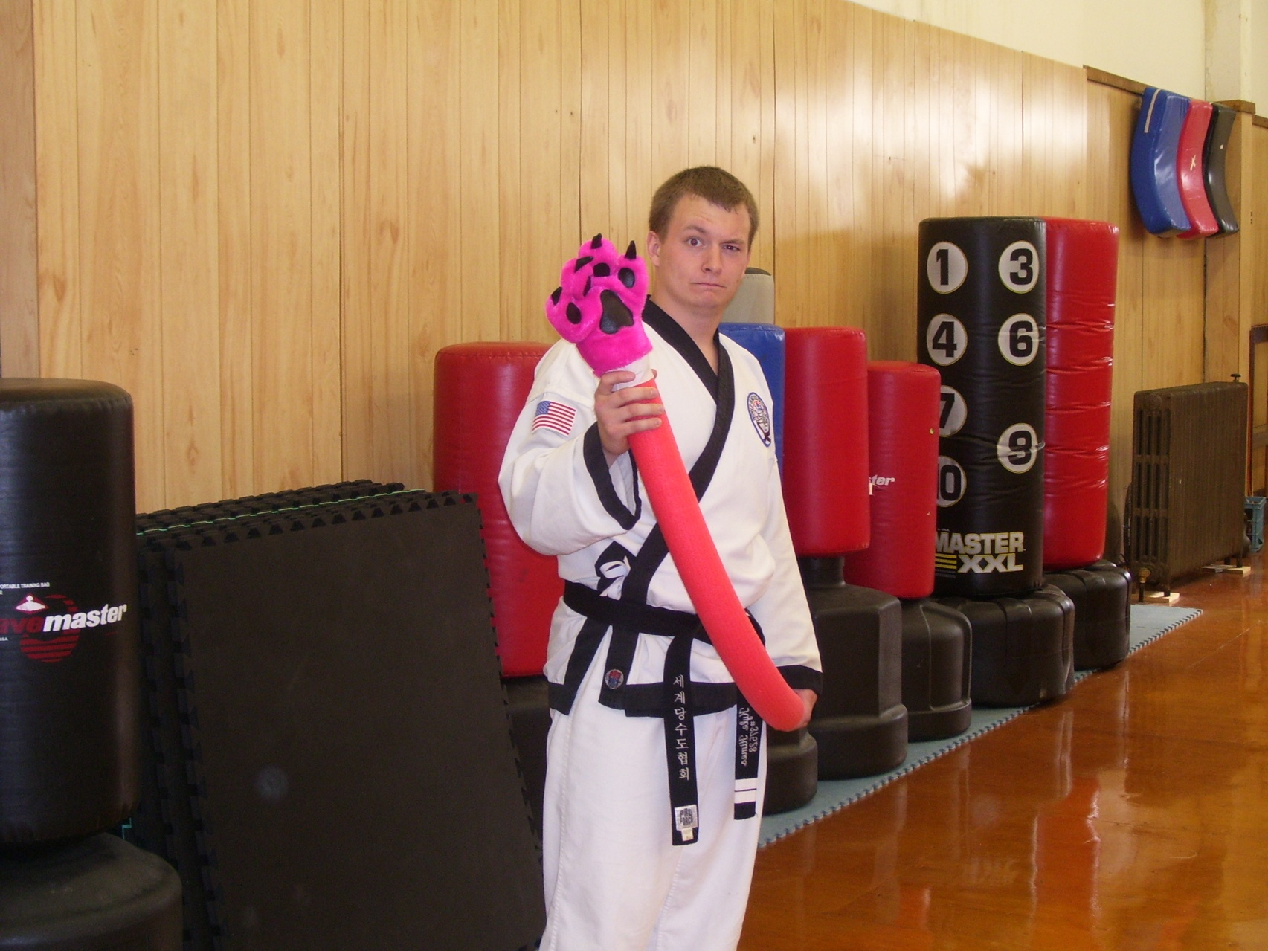
My Presentation

Slide 3
Very Brief History South Korea

Slide 4
Jea Chul Shin

Slide 5
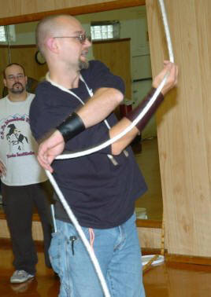
Scott Homshek

Slide 6
Phases Throughout Project
Observe
Learn
Teach

Slide 7
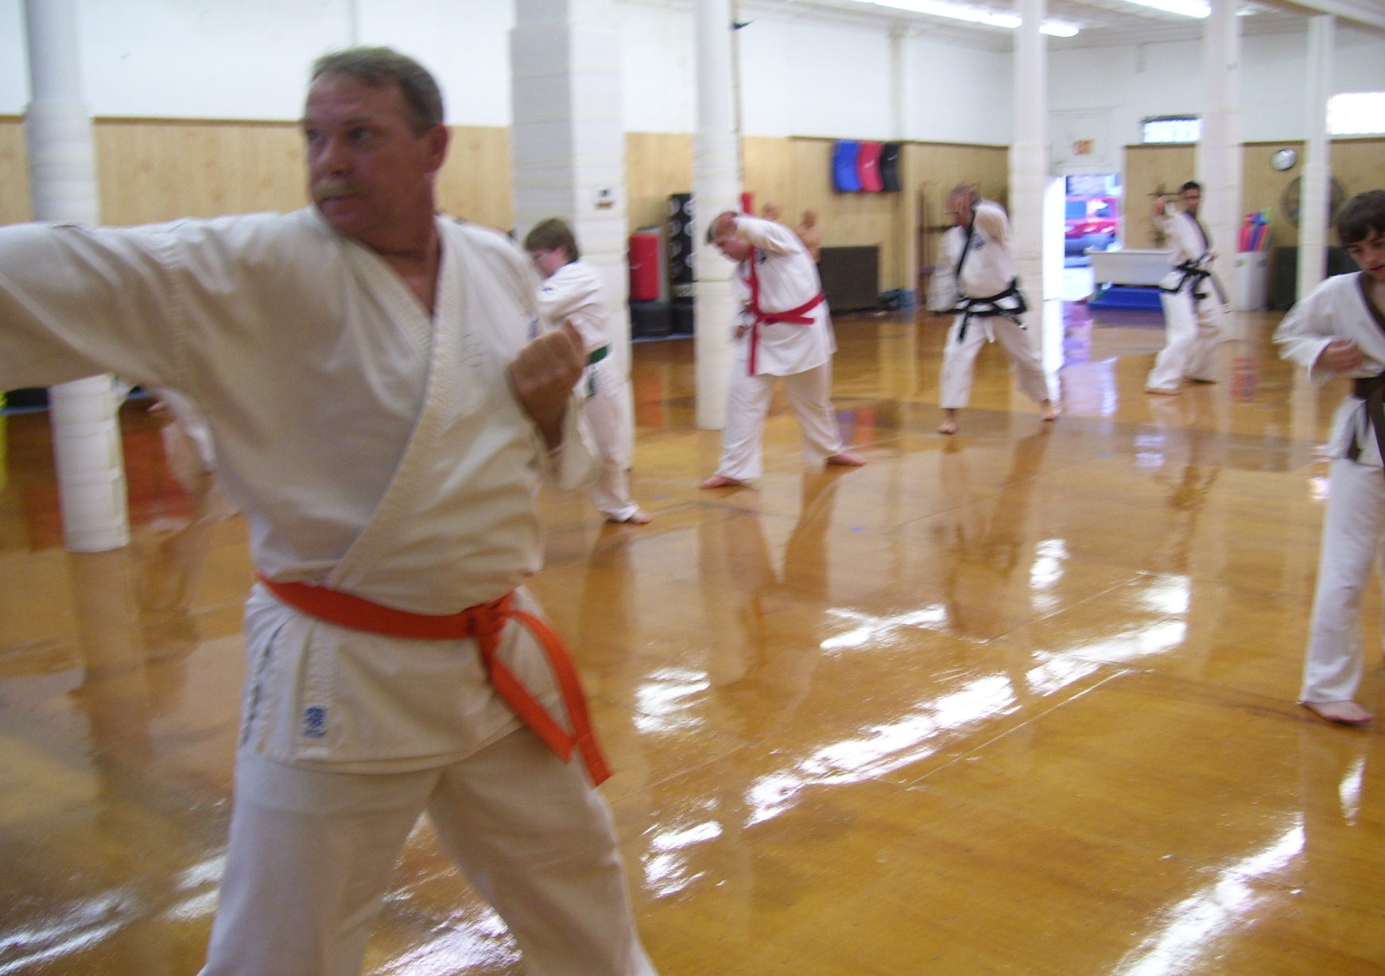
Observing Phase

Slide 8
What Did I Observe?
Proper position in the room
How to best utilize extra instructors and equipment
How to handle special students/cases
Various teaching methods

Slide 9
Teaching Methods
The Fun method of teaching.
The Serious method of teaching.
The Questioning method of teaching.

Slide 10
Learning Types
Tactile
Visual
Auditory

Slide 11
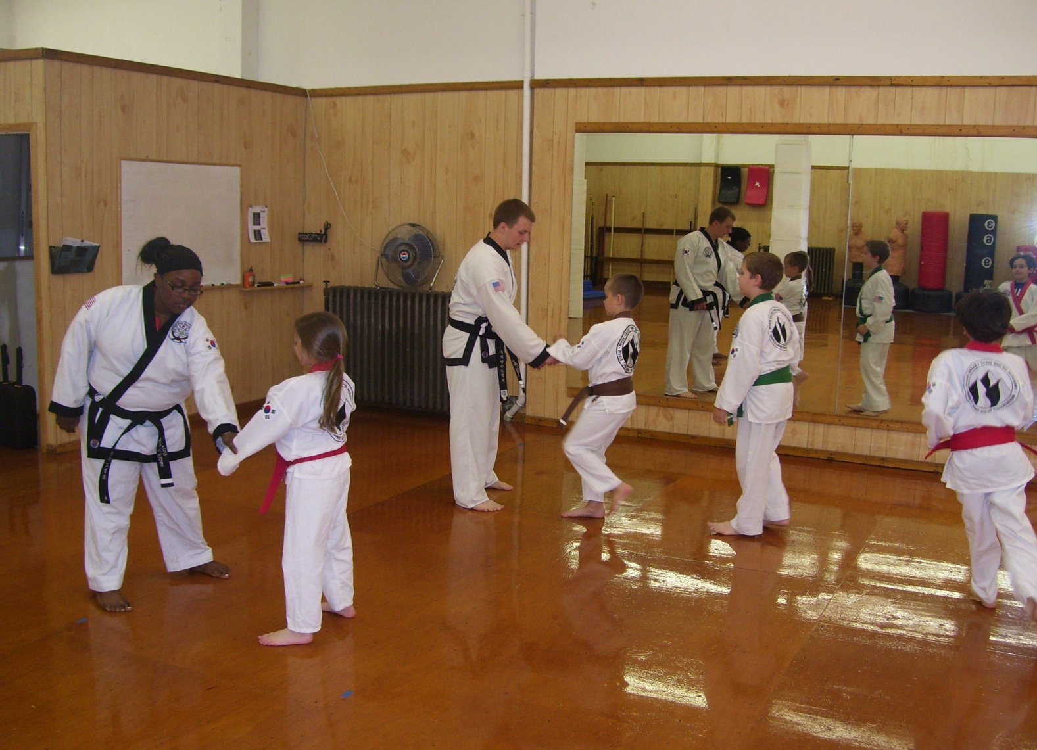
Learning Phase

Slide 12
Duties of the Instructor
Oversee Overall operation of school
Specializing in fields outside but related to the martial arts
Teach a good Solid class

Slide 13
Instructor’s Arsenal
Knowledge of Human Anatomy, Human Psychology, and body language and Expert knowledge of his base art and various other arts.
Knowledge of various weapons

Slide 14
Paper Work….
Grading Tests
Signing Up New Students
Making Reciepts

Slide 15
Teaching Phase

Slide 16
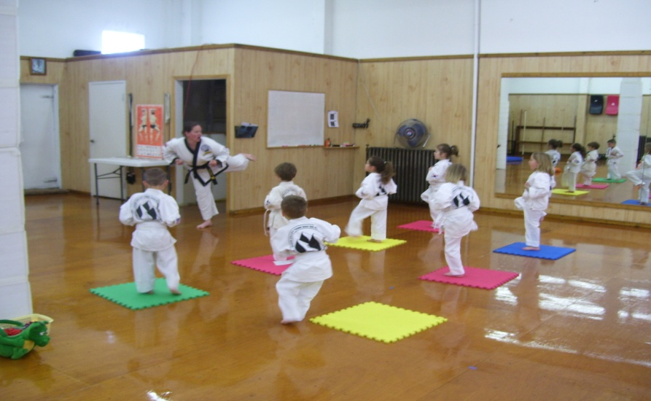
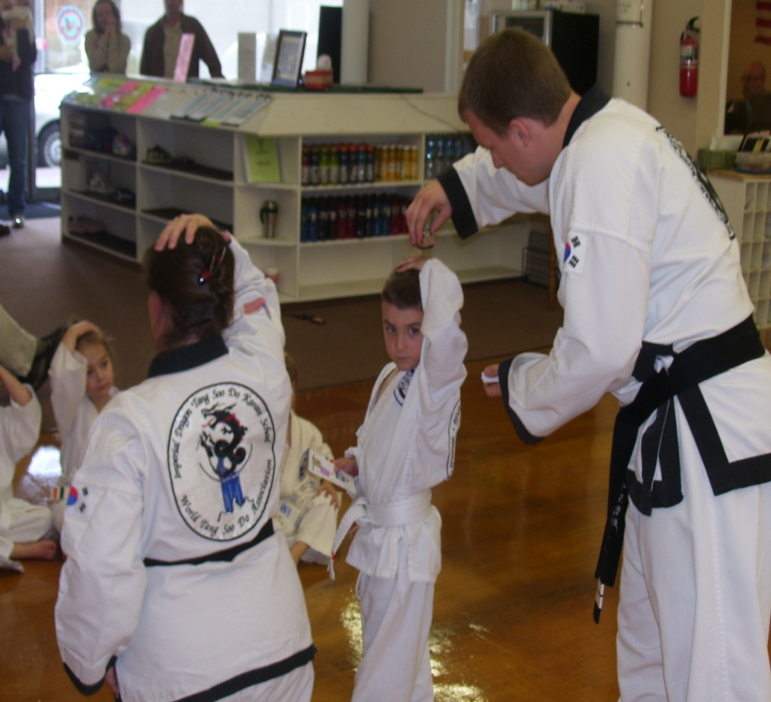
What I Taught
Taught Young Children (Ages 4-6)

Slide 17
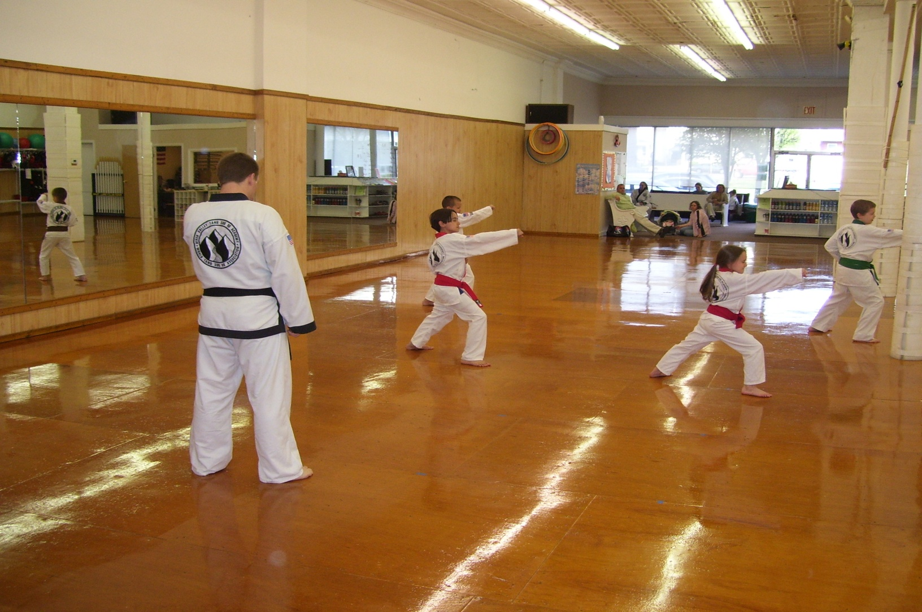
What I Taught continued
Taught Older Children (Ages 7-13)

Slide 18
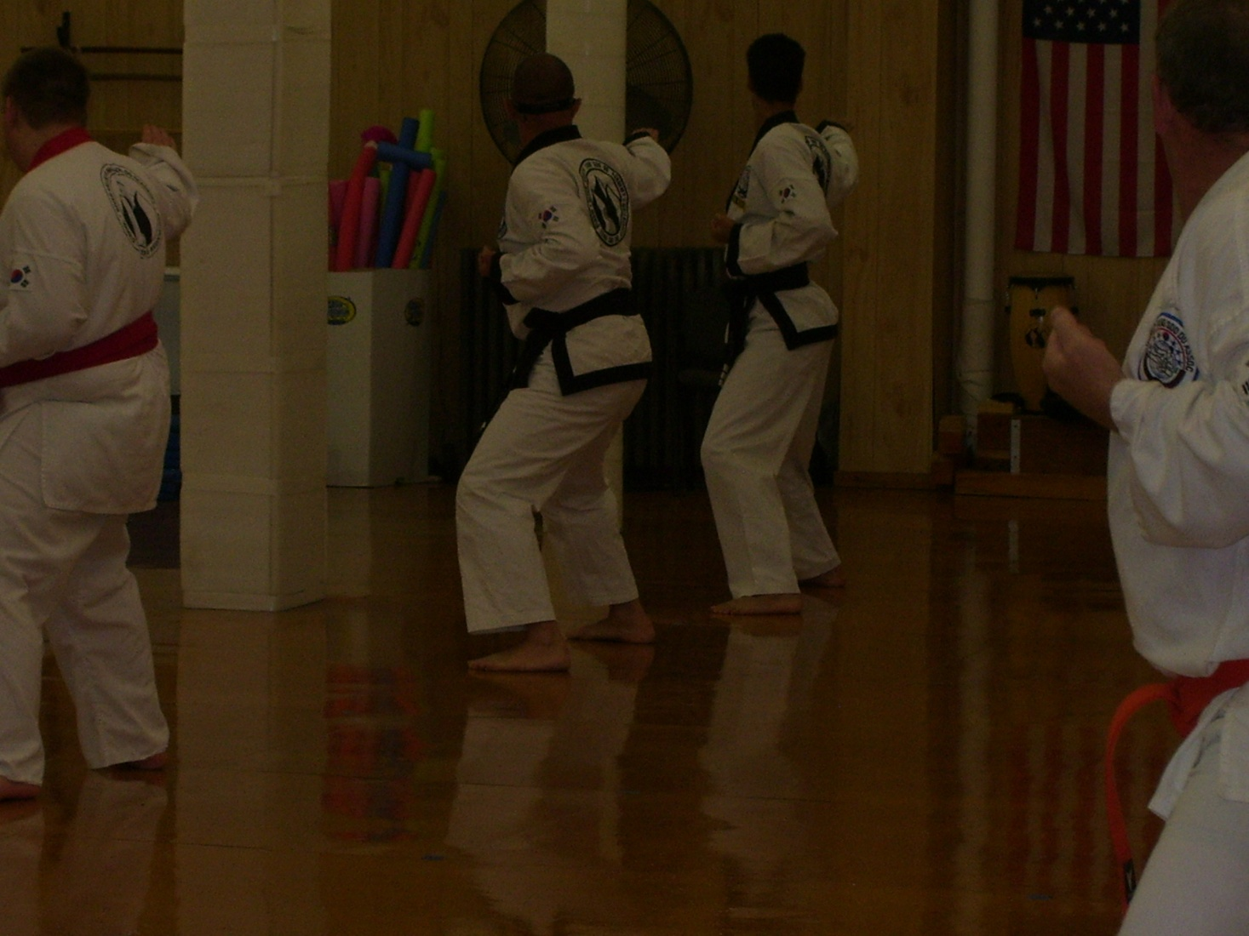
What I Taught Continued
Taught Adults

Slide 19
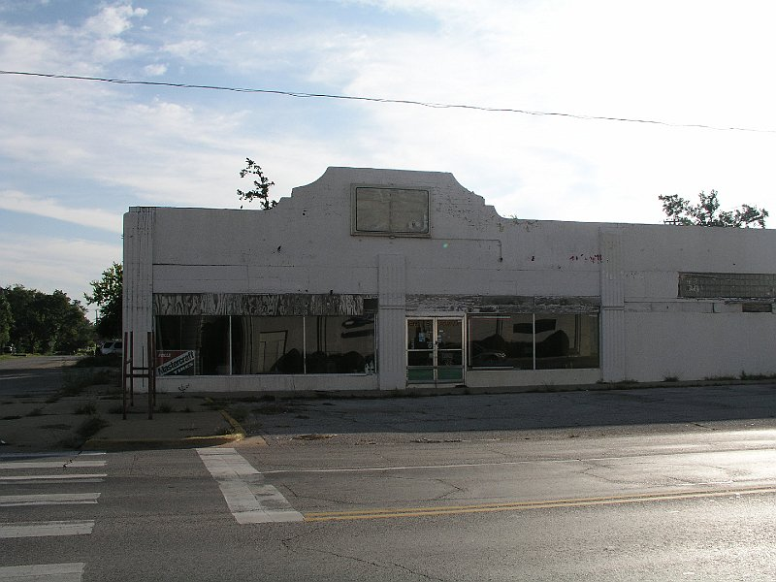
My Plans

Slide 20
Any Questions?

